Slide 1
Best Practices and Steps to Counter Cyber Security Attacks

Slide 2
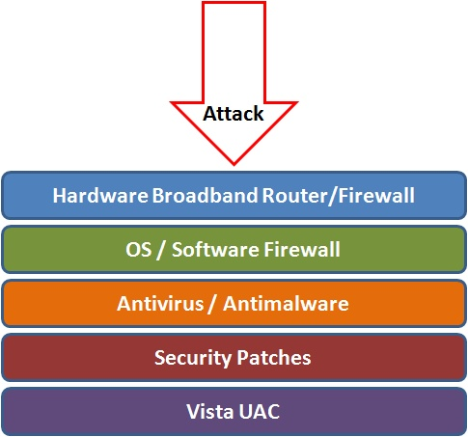
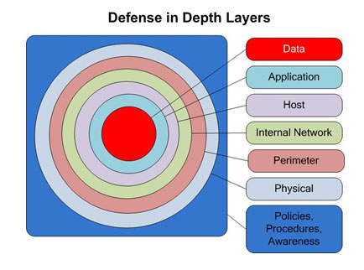
Best Practices to avoid these threats
Defense in depth uses multiple layers of defense to address technical, personnel and operational issues.
User Account Controls

Slide 3
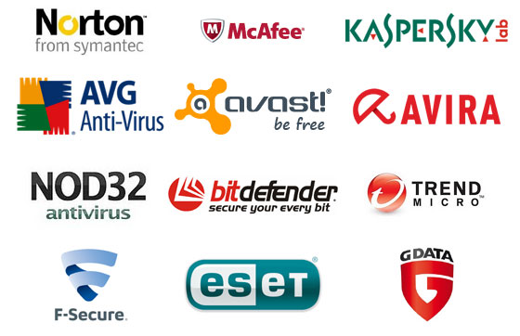
Anti-virus and Anti-spyware Software
Anti-virus software detects certain types of malware and can destroy it before any damage is done.
Install and maintain anti-virus and anti-spyware software.
Be sure to keep anti-virus software updated.
Many free and commercial options exist.
Contact your Technology Support Professional for assistance.

Slide 4
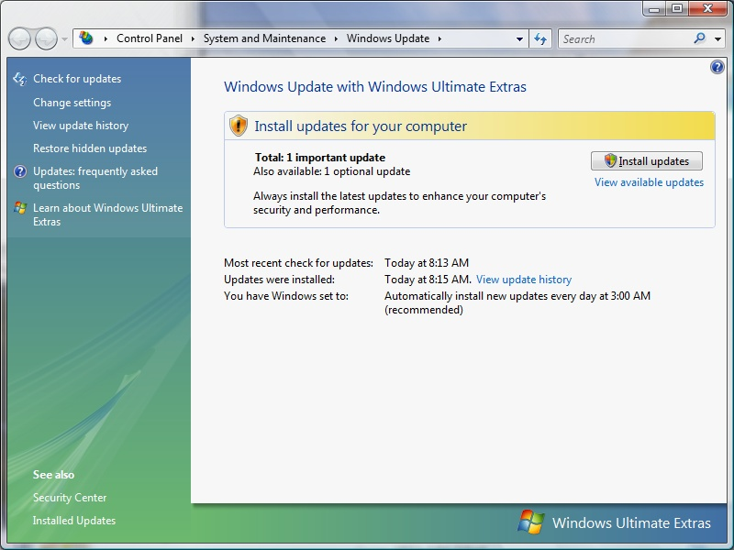

Protect your Operating System
Microsoft regularly issues patches or updates to solve security problems in their software. If these are not applied, it leaves your computer vulnerable to hackers.
The Windows Update feature built into Windows can be set up to automatically download and install updates.
Avoid logging in as administrator
Apple provides regular updates to its operating system and software applications.
Apply Apple updates using the App Store application.

Slide 5
Use Strong Passwords
Make passwords easy to remember but hard to guess
USG standards:
Be at least ten characters in length
Must contain characters from at least two of the following four types of characters:
English upper case (A-Z)
English lower case (a-z)
Numbers (0-9)
Non-alphanumeric special characters ($, !, %, ^, …)
Must not contain the user’s name or part of the user’s name
Must not contain easily accessible or guessable personal information about the user or user’s family, such as birthdays, children’s names, addresses, etc.

Slide 6

Avoid Social Engineering and Malicious Software
Do not open email attachments unless you are expecting the email with the attachment and you trust the sender.
Do not click on links in emails unless you are absolutely sure of their validity.
Only visit and/or download software from web pages you trust.

Slide 7

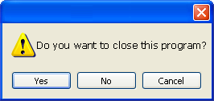
Avoid Hacker Tricks
Be sure to have a good firewall or pop-up blocker installed.
Pop-up blockers do not always block ALL pop-ups so always close a pop-up window using the ‘X’ in the upper corner.
Never click “yes,” “accept” or even “cancel.”
Infected USB drives are often left unattended by hackers in public places.

Slide 8
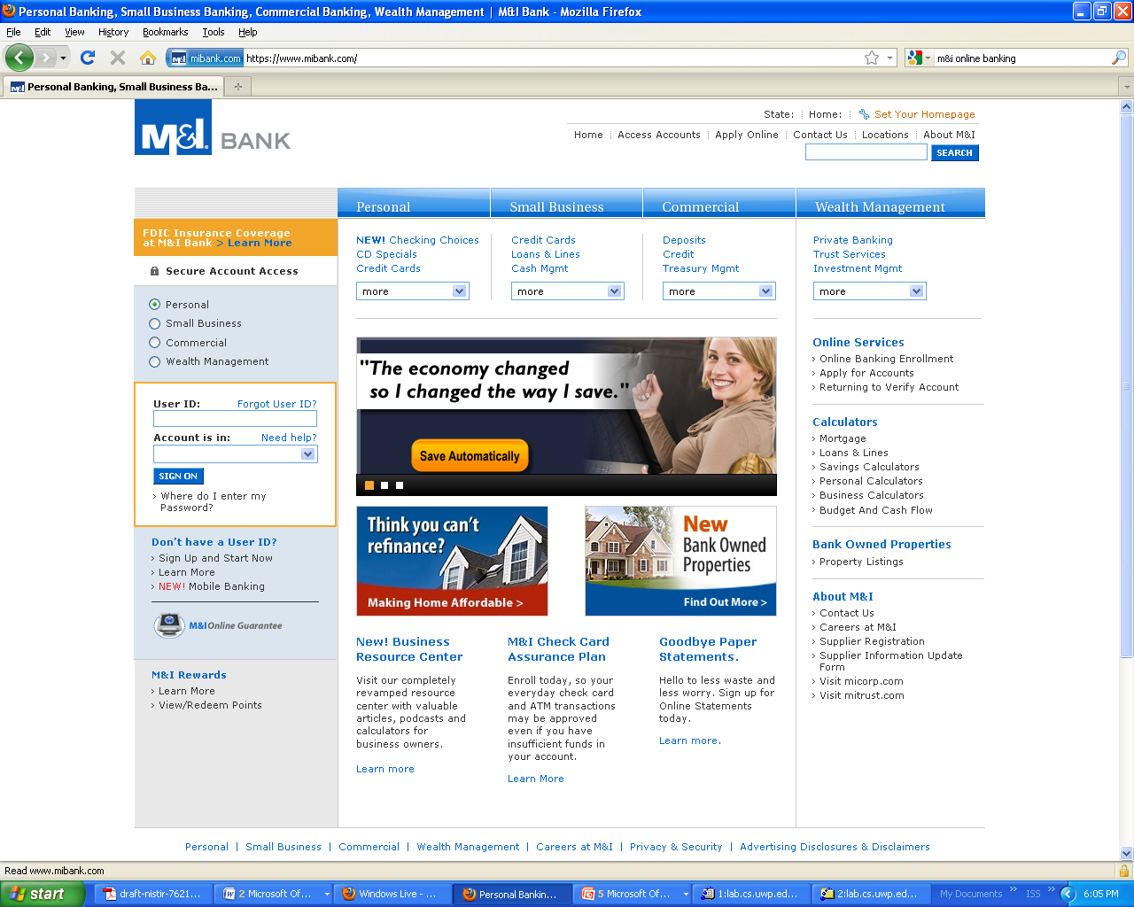
Secure Business Transactions
https://
Symbol indicating
enhanced security

Slide 9

Backup Important Information
No security measure is 100% reliable.
Even the best hardware fails.
What information is important to you?
Is your backup:
Recent?
Off-site & Secure?
Process Documented?
Encrypted?
Tested?

Slide 10
Thank You

